Slide 1
Predicting Stock Prices in Python using Machine Learning
Brandon Koch and Pratik Maitra

Slide 2
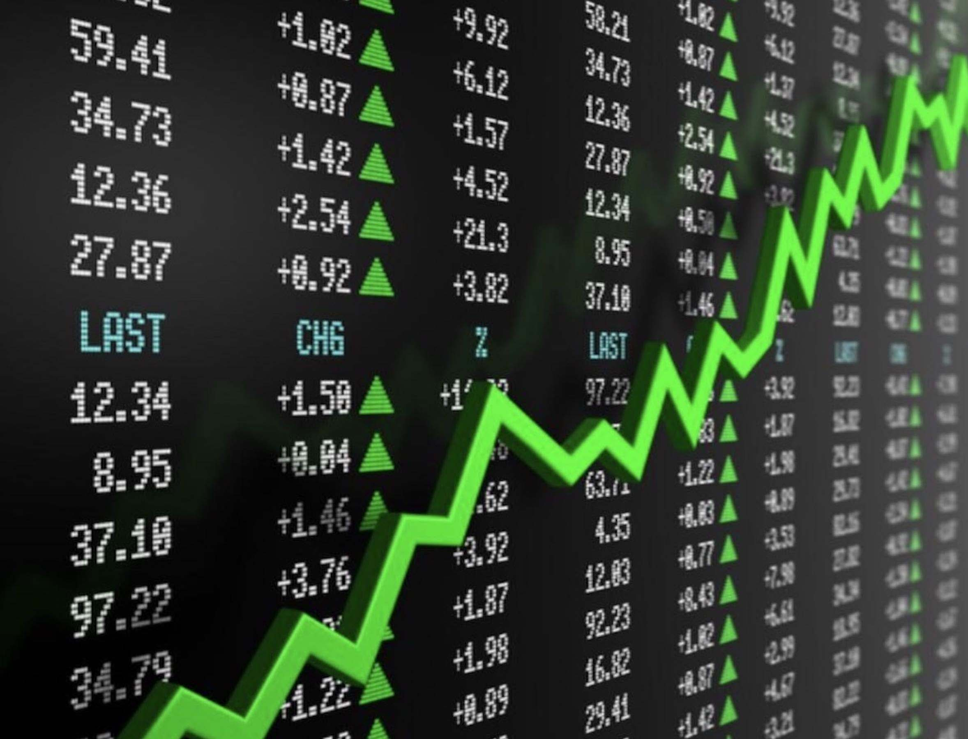
Introduction
Related Work
Our Approach
Performance Evaluation
Conclusion

Slide 3
Introduction
Stock markets have existed in the United States for over 200 years
Yet very few people can accurately predict future stock prices
The ability to predict stock prices is very beneficial
Stock prices falling soon --> sell now
Stock prices rising soon --> buy now
Both will earn money when executed properly
Common “what if” scenarios
If you invested $500 in Tesla in 2010 --> over $125,000 today
If you invested $500 in Amazon in 1997 --> over $1.1 million today
Why is it so difficult to predict future stock prices?

Slide 4
Introduction (continued)
There are too many factors to consider
Supply and Demand
Company performance
Inflation / Deflation
Politics
Human error / bias
Emotional
Have preferences
We can improve our predictions by using Machine Learning models
Better at identifying trends
Continually improves
Automates the process

Slide 5
Related Work
Existing approaches to stock price prediction have many flaws
Momentum Investing
Predicting that current market trends will continue
Trends are often short term, then the market corrects
Value Investing
Selecting undervalued stocks that have high potential
Purchasing high volumes of unproven stocks is very risky
Mean Reversion
Anticipating stocks will return to average values over time
Usually not successful in the short term, may take years to develop

Slide 6
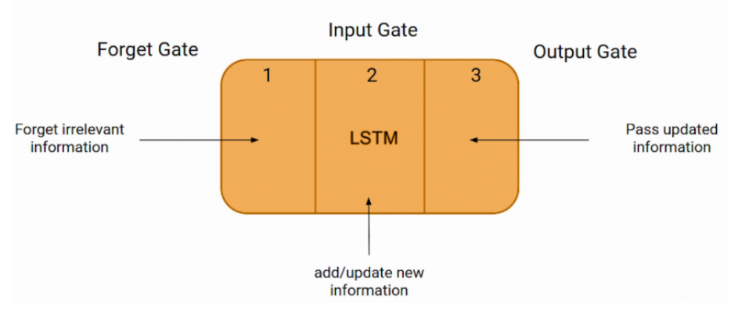
Our Approach
Long Short-Term Memory (LSTM)
Linear Regression
Support Vector Machine (SVM)
LSTM
A type of recurrent neural network with 3 layers

Slide 7
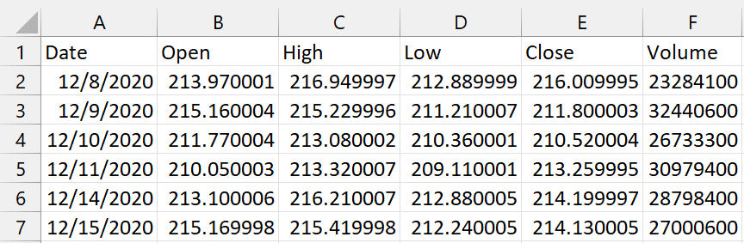
Our Approach (LSTM)
Data Collection / Setup
Download daily stock price CSV files from Yahoo Finance
Read CSV files into python with pandas
Reshape data into arrays with numpy
Model 1
Train LSTM model with keras
Looking specifically at open prices
Use 50 epochs and batch size of 32
Model 2
Train LSTM model with sklearn
Looking at open, high, low, volume
Use 100 epochs and batch size of 8
Model 2
Model 1

Slide 8
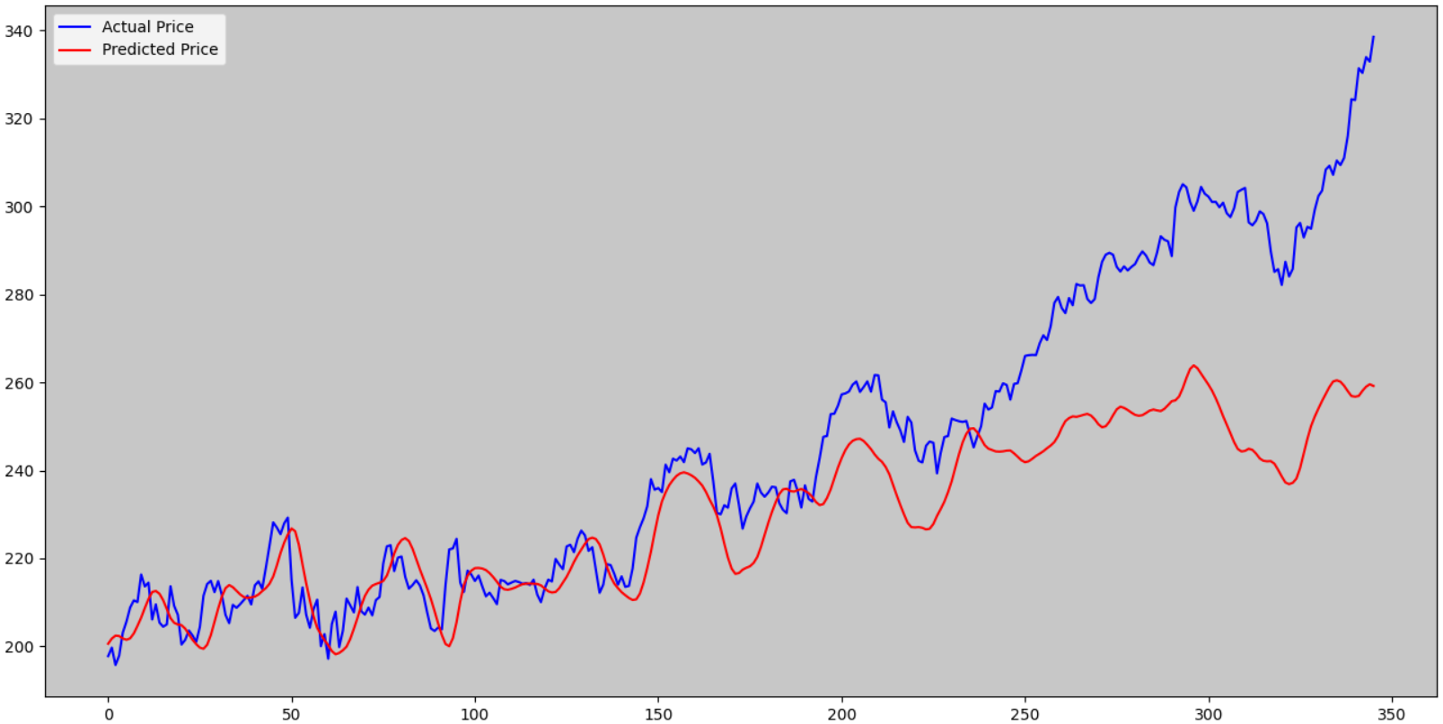
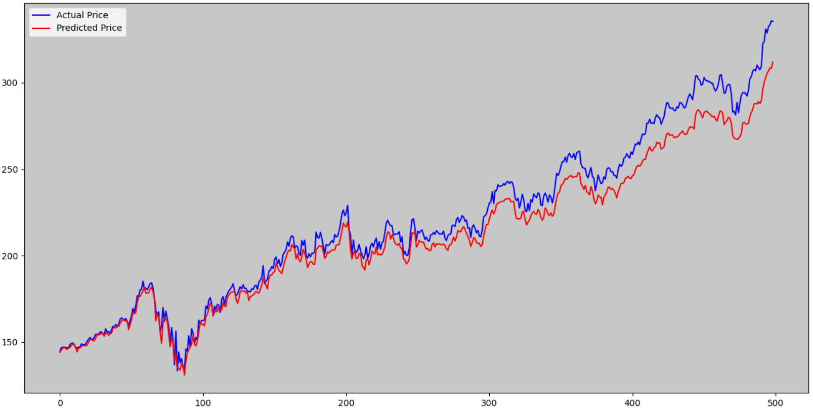
MSFT (Microsoft)
Our Approach (LSTM)
Model 1
Model 2

Slide 9
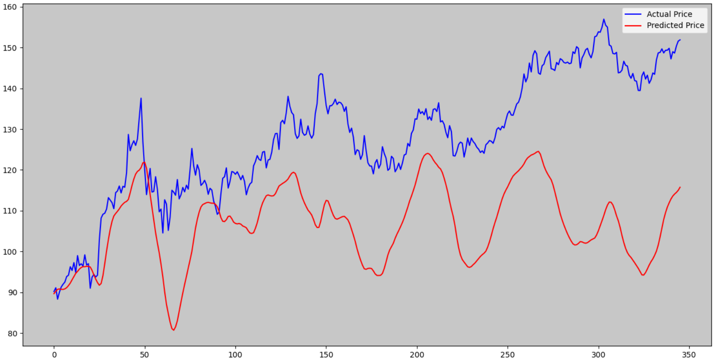
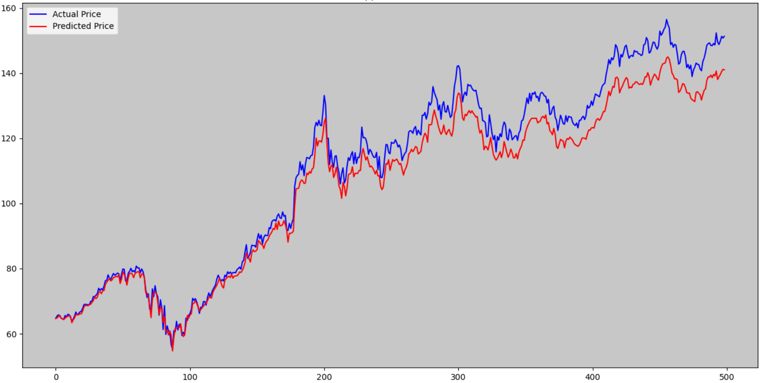
AAPL (Apple)
Our Approach (LSTM)
Model 1
Model 2

Slide 10
Our Approach (Regression Techniques)
Linear Regression
Linear Regression makes use of two separate variables(namely time and stock price) to define a single relationship between the two.
Using linear regression, a trader can identify key price points—entry price, stop-loss price, and exit prices.
A stock's price and time period determine the system parameters for linear regression, making the method universally applicable.
Here we take past stock prices as a dataset. We have mainly used the historical stock prices of companies like Microsoft, Apple and Tesla to predict the prices of the companies.
The beauty of linear regression is that the security's price and time period determine the system parameters.
We will observe how even simple regression models can help stock traders come up with how stocks would behave in the future.

Slide 11
Our Approach (Regression Techniques)
Ridge and Lasso Regression
Ridge and Lasso Regression are a modified form of Linear regression
We apply both models to compare how they fare against a more direct Linear regression method
Both Ridge and Lasso regression methods are applied with and without Cross Validation measures
Cross Validation plays an important role in making sure the model predictions match the actual predicted data without too much deviation
To implement the regression models we use the scikit library in python which implements both models with a variety of in built features
Model Used
Linear Regression functions from scikit library
Ridge and Ridge CV functions from scikit library
Lasso and LassoCV functions from scikit library

Slide 12
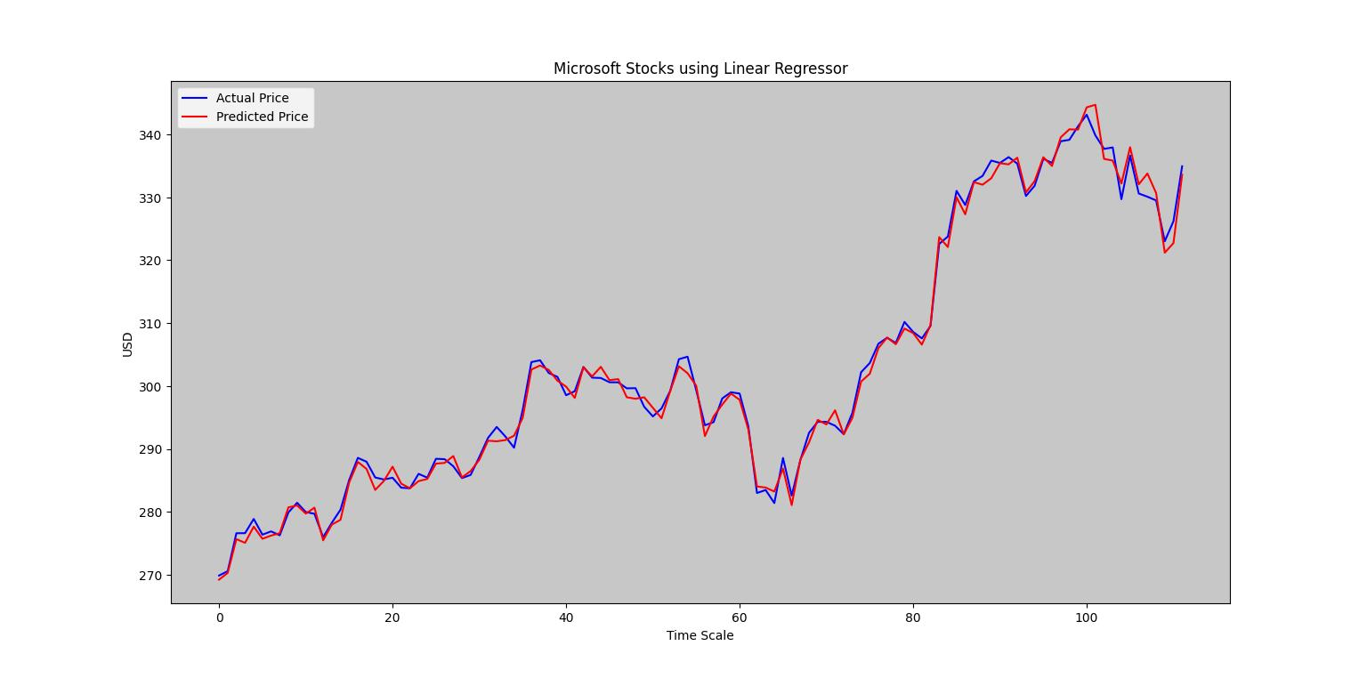
Our approach(Regression)
Microsoft Stock Prices using Linear, Ridge and Lasso

Slide 13
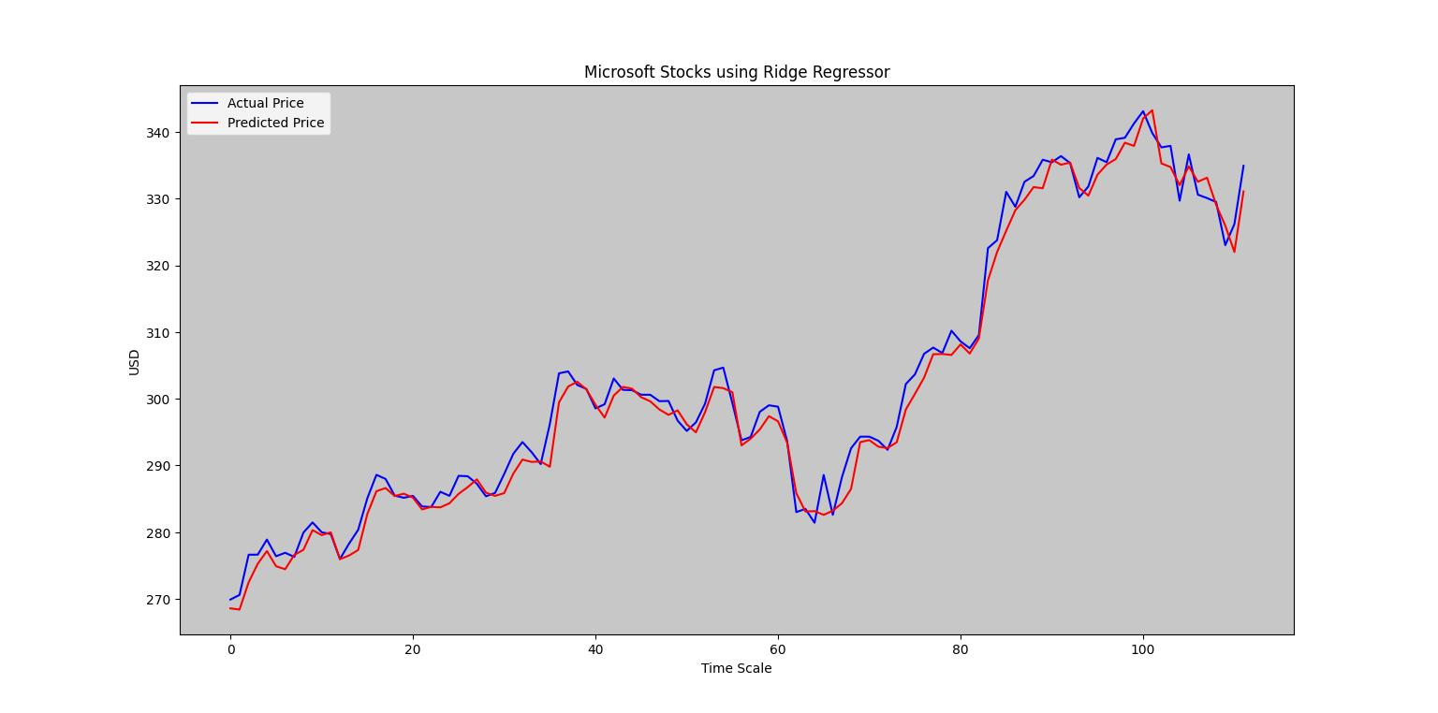
Our approach(Regression)
Microsoft Stock Prices using Linear, Ridge and Lasso

Slide 14
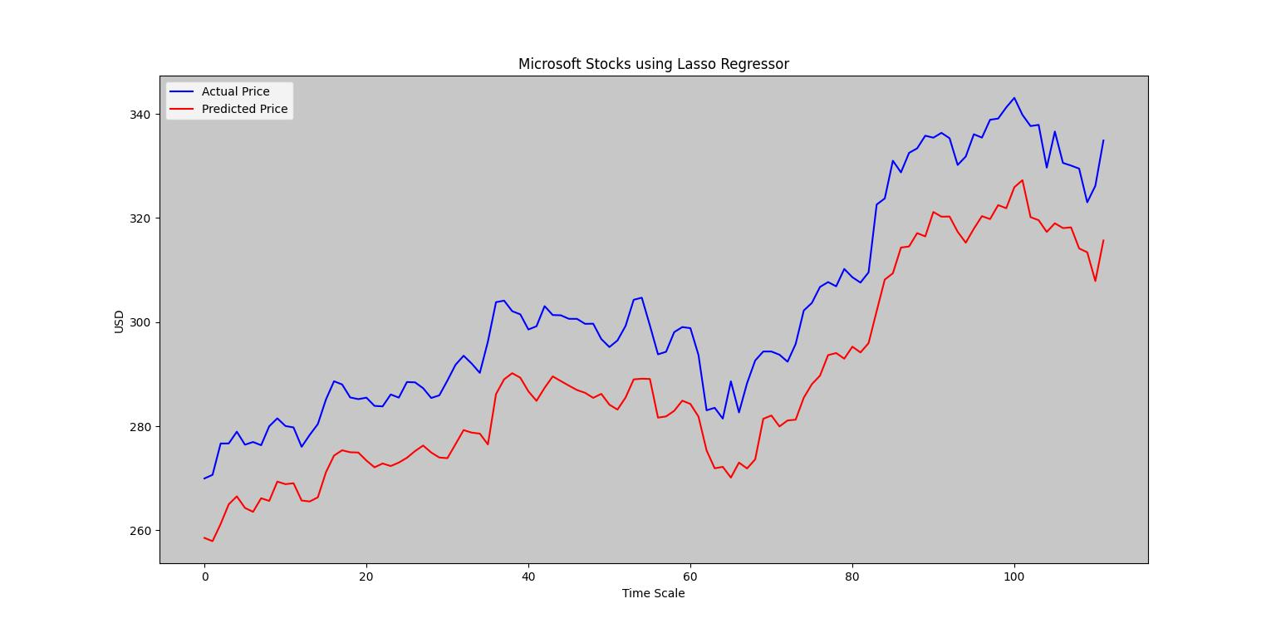
Our approach(Regression)
Microsoft Stock Prices using Linear, Ridge and Lasso

Slide 15
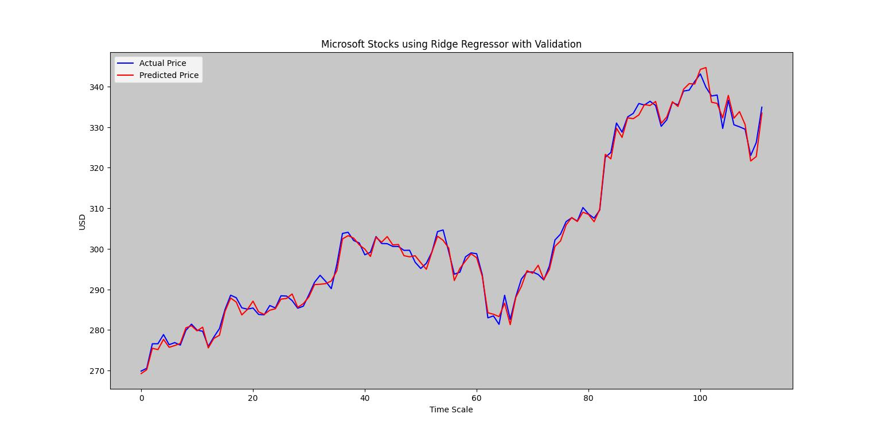
Our approach(Regression)
Microsoft Stock Prices using Linear, Ridge and Lasso

Slide 16
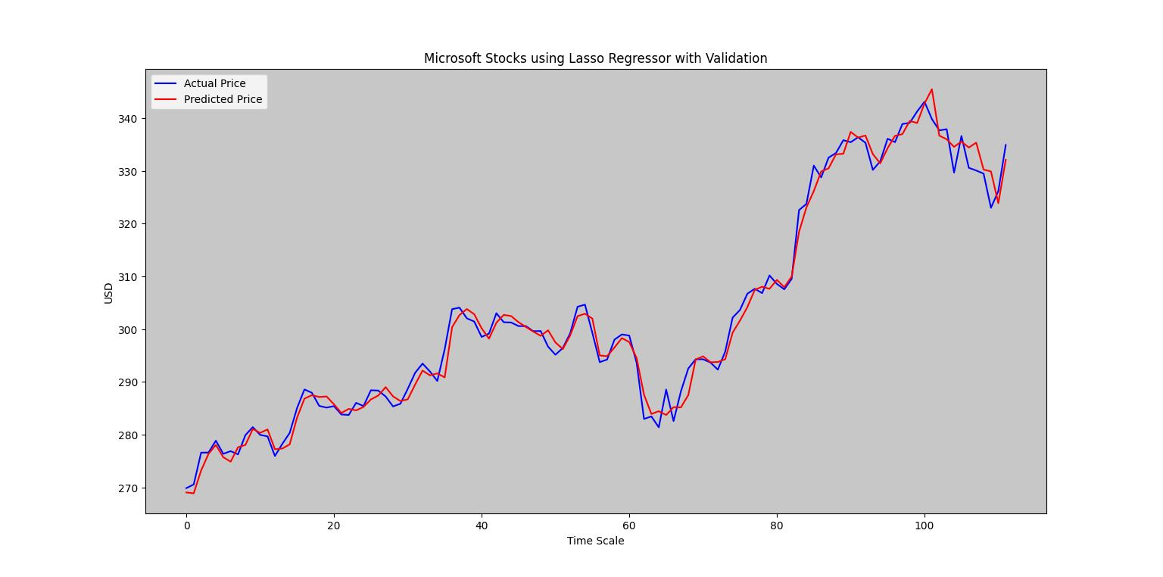
Our approach(Regression)
Microsoft Stock Prices using Linear, Ridge and Lasso

Slide 17
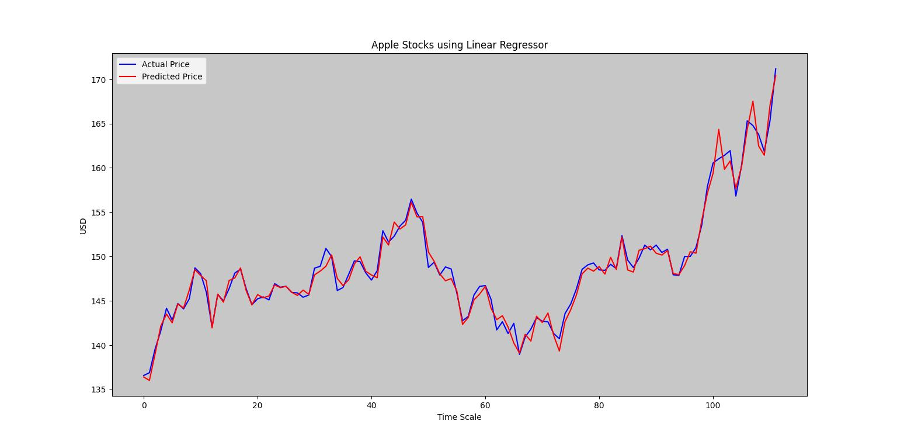
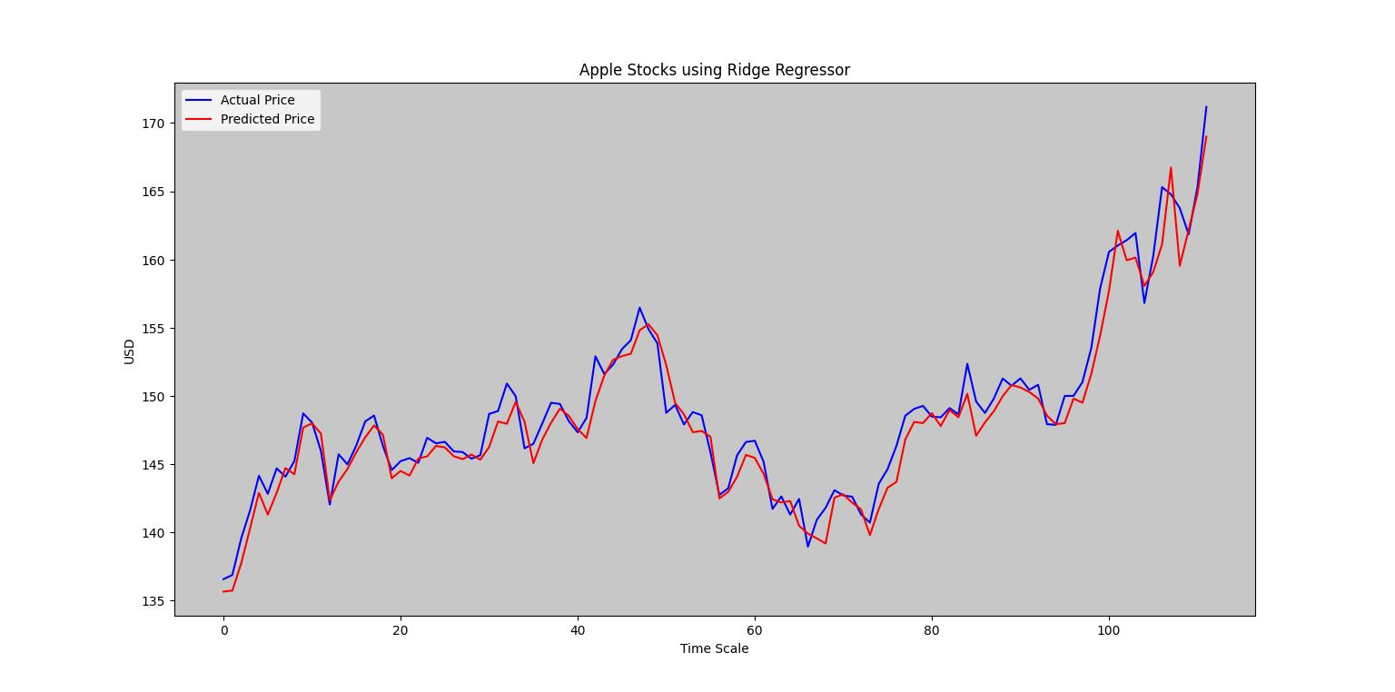
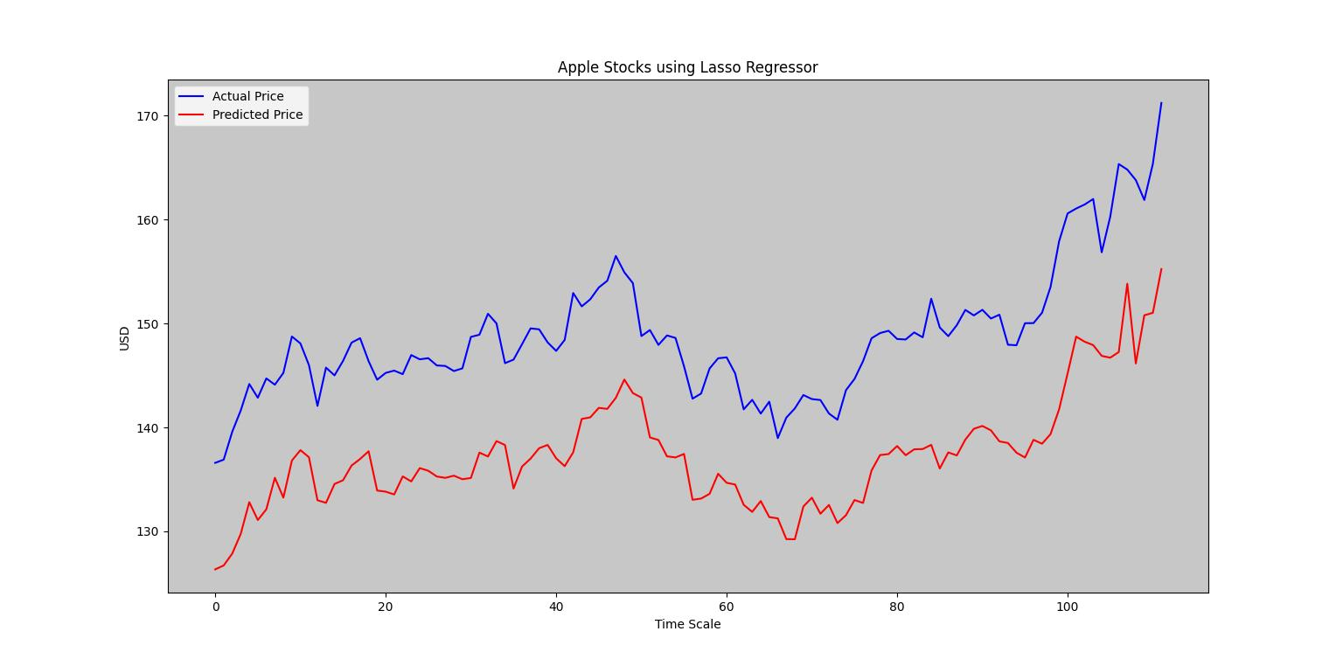
Our approach(Regression)
Apple Stock Prices using Linear, Ridge and Lasso

Slide 18

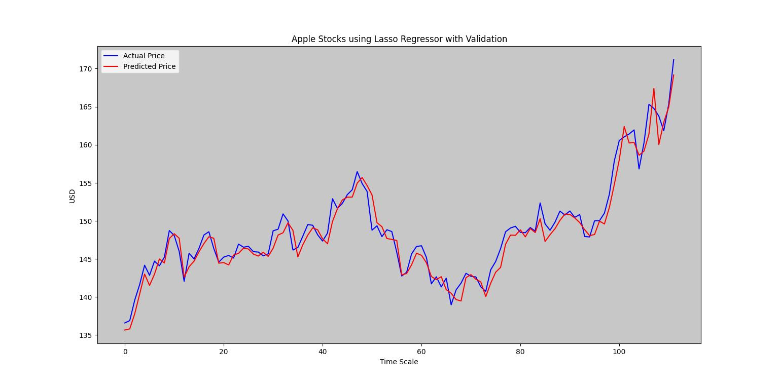
Our approach(Regression)
Apple Stock Prices using Linear, Ridge and Lasso(with Validations)

Slide 19
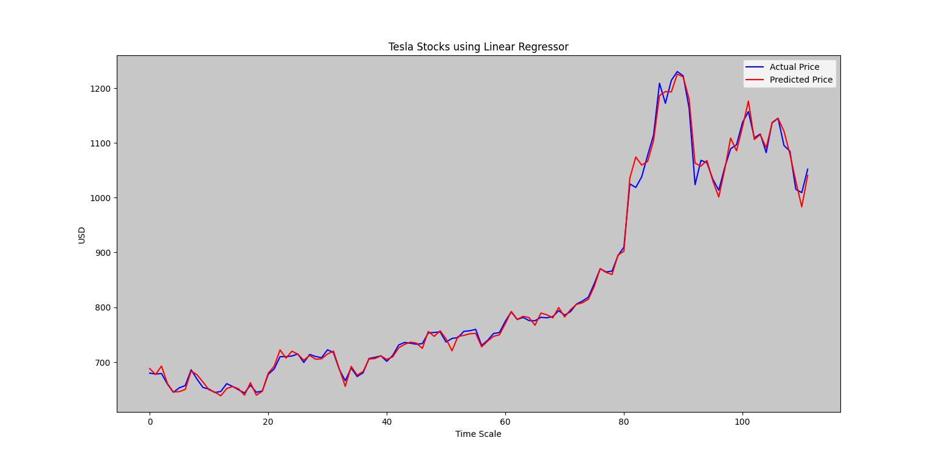


Our approach(Regression)
Tesla Stock Prices using Linear, Ridge and Lasso

Slide 20
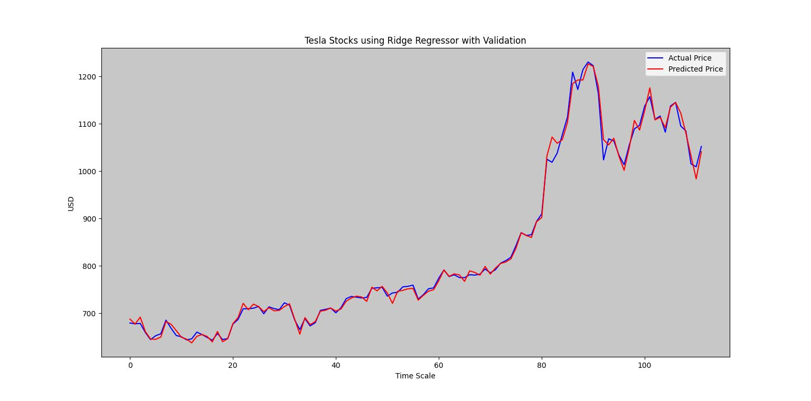
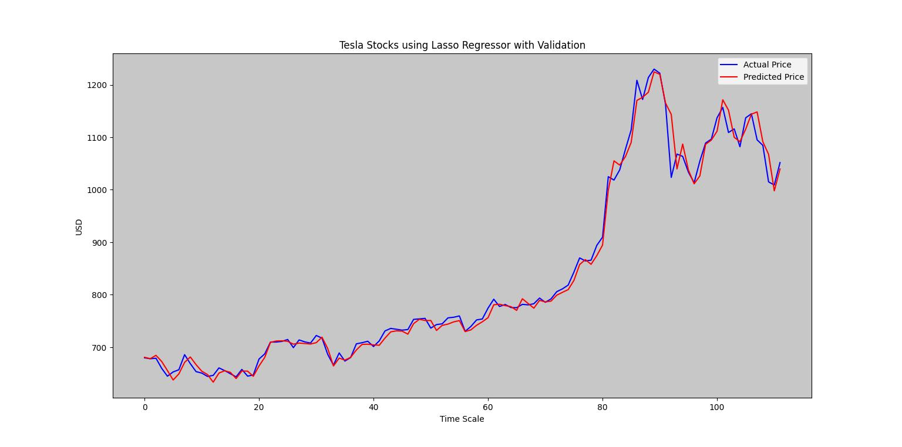
Our approach(Regression)
Tesla Stock Prices using Linear, Ridge and Lasso(with Validations)

Slide 21
Our Approach (Regression Techniques)
Initial Observations
Linear Regression provides best fit for future stock prices
Ridge and Lasso without validation perform worse than Linear regression
With validation, ridge performs nearly as well as Linear regression
Lasso regression with validation also shows improved performance

Slide 22
Our Approach (SVM)
Support Vector Machine
Support Vector Machines are one of the best binary classifiers.
They create a decision boundary such that most points(support vectors) in one category fall on one side of the boundary while most points in the other category fall on the other side of the boundary.
We define the linear boundary as the optimal hyperplane.
The optimal hyperplane is such that we maximize the distance from the plane to any point. This is known as the margin.
The maximum margin hyperplane (MMH) best splits the data.
The concept of the SVC is similar to the popular linear regression model.
Model(Linear SVM,RBF SVM, Kernel SVM)
We use scikit library to model the SVM using Linear, RBF and Kernel

Slide 23
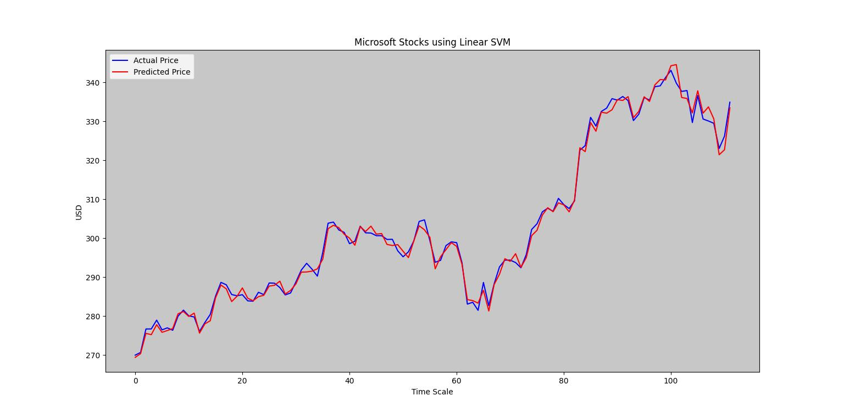
Our Approach (SVM)
Support Vector Machine
Microsoft Stock Prices using Linear, RBF and Poly Kernel SVM

Slide 24
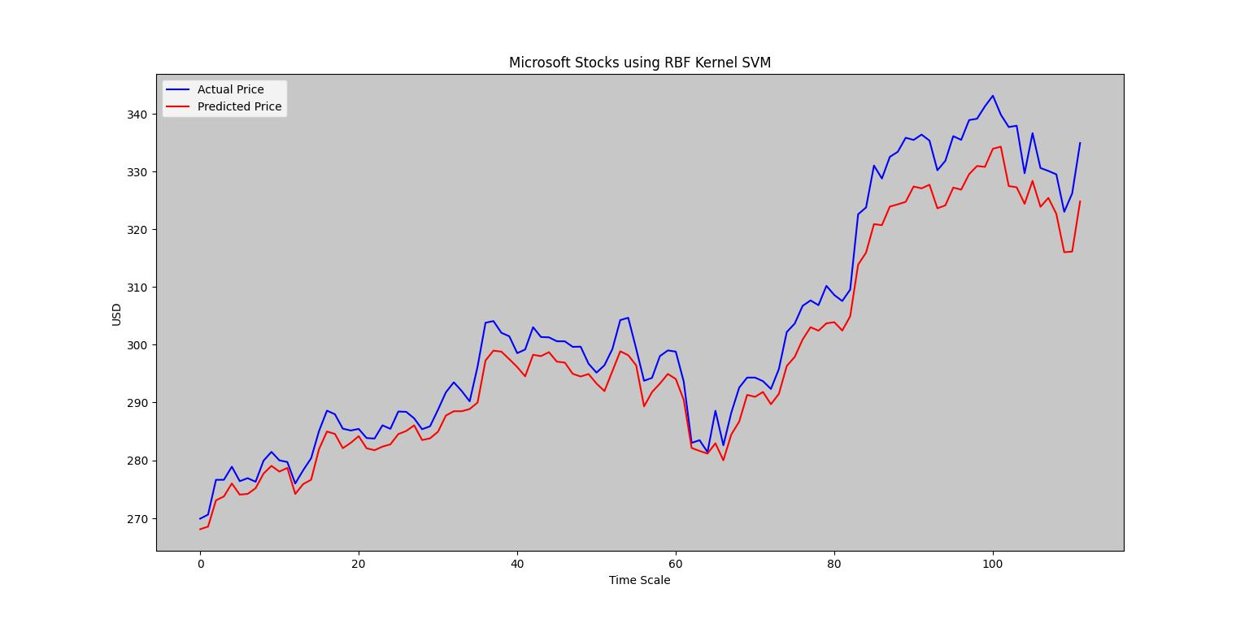
Our Approach (SVM)
Support Vector Machine
Microsoft Stock Prices using Linear, RBF and Poly Kernel SVM

Slide 25
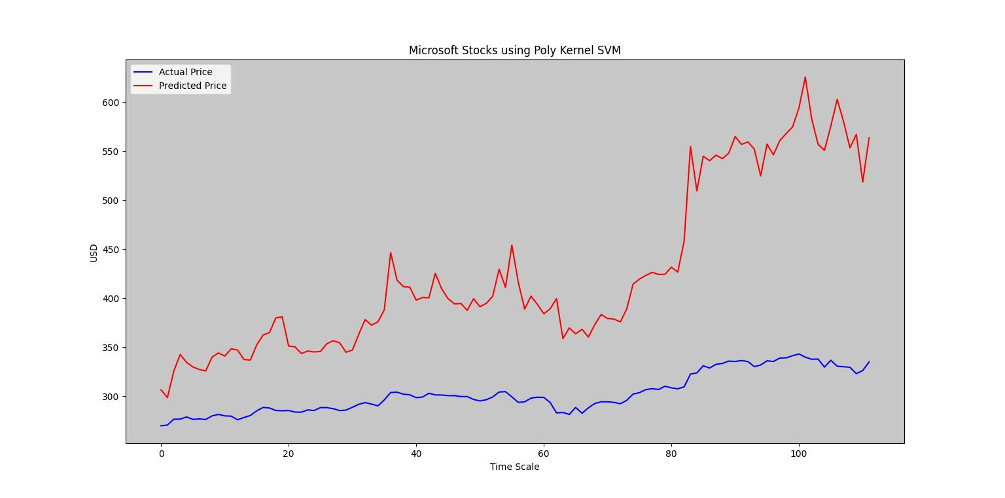
Our Approach (SVM)
Support Vector Machine
Microsoft Stock Prices using Linear, RBF and Poly Kernel SVM

Slide 26

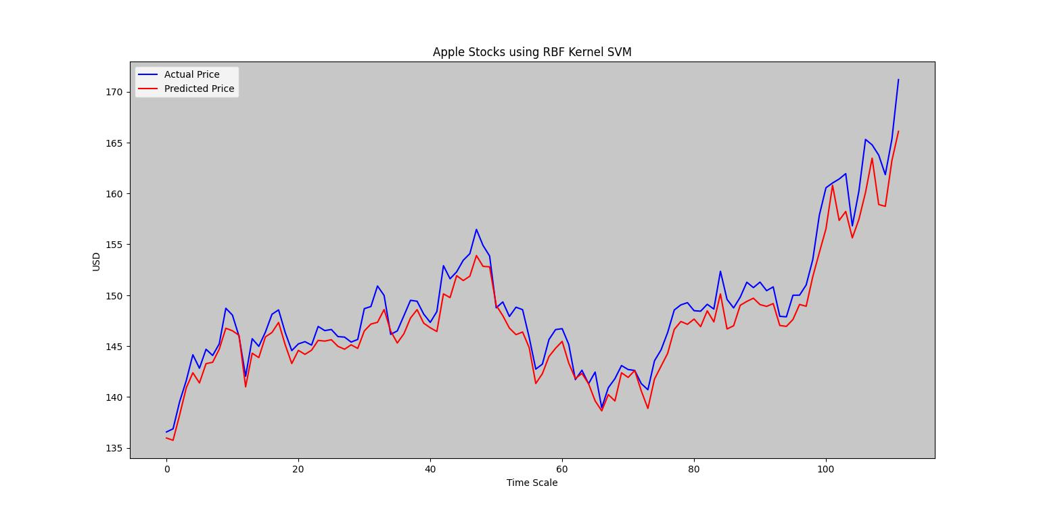
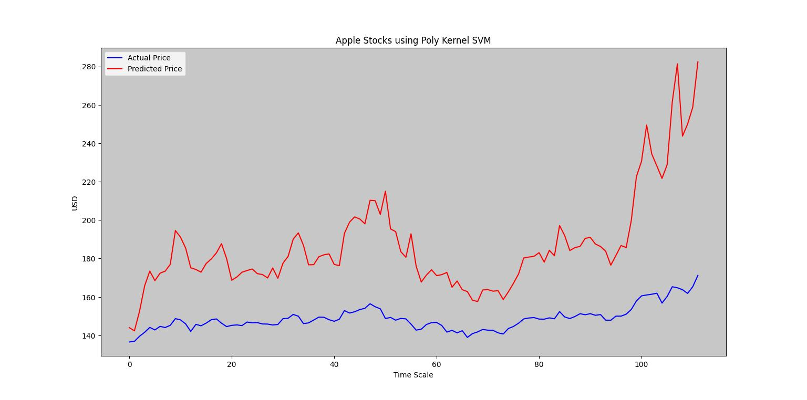
Our Approach (SVM)
Support Vector Machine
Apple Stock Prices using Linear, RBF and Poly Kernel SVM

Slide 27

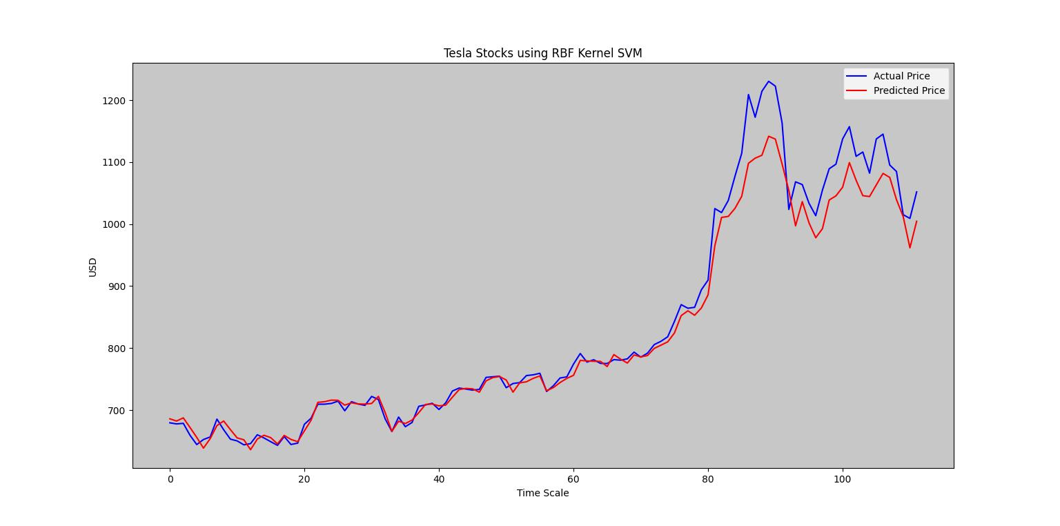
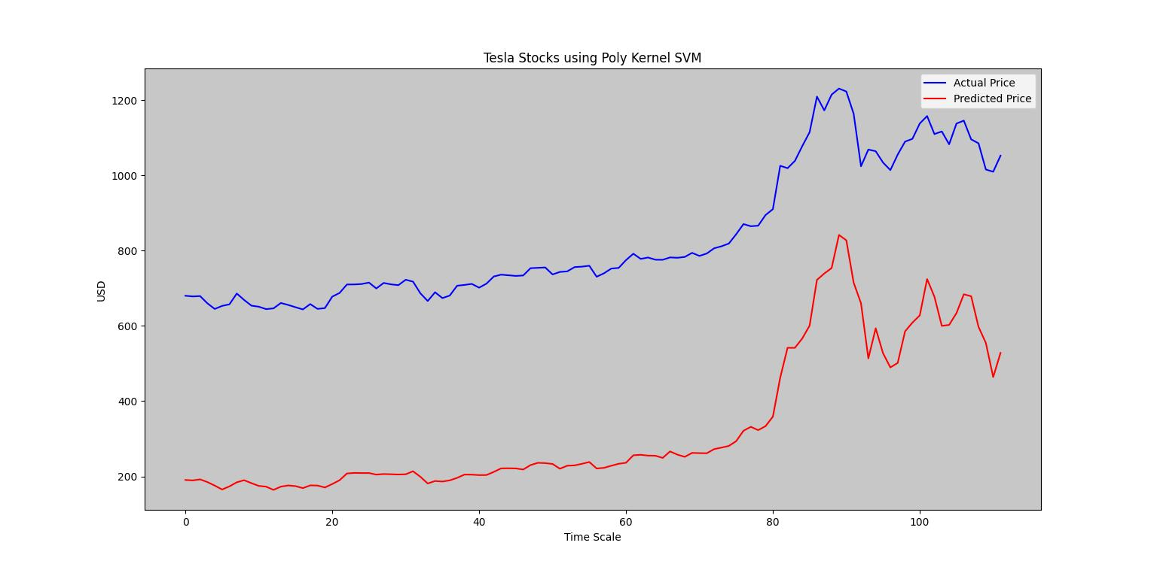
Our Approach (SVM)
Support Vector Machine
Tesla Stock Prices using Linear, RBF and Poly Kernel SVM

Slide 28
Our Approach (SVM)
Support Vector Machine
Initial Observations
Linear SVM seems to provide the best modelling for the stock prices
The second best modelling is provided by RBF kernel SVM
Linear SVM as it is similar to Linear Regression is a good choice for predicting stock prices

Slide 29
Performance Evaluation
To compare the performance we calculate the RMSE values for the models

Slide 30
Performance Evaluation
We observe that Linear Regression, Ridge Regression with CV and Linear SVM all provide a good modelling for the stock price data sets.
For Microsoft stock prices, Ridge regression with CV has provided the best fit and lowest error. It is followed by Linear SVM and Linear Regression modelling.
For Apple stock prices, Linear SVM has performed the best followed closely by linear regression and ridge regression with CV
For Tesla stock prices, Ridge regression with CV is the best modelling technique. It is followed by Linear Regression and Linear SVM
In nearly all the stocks, SVM with poly kernel has performed the worst.
Among regression models, Lasso Regression without CV has performed the worst.

Slide 31
Conclusion
Our conclusion at the end of this project is that for stock price datasets we can implement Ridge Regression with cross validation, Linear Regression, Linear SVM and LSTM 2 modelling to forecast future stock prices
Among these modelling Linear Regression provides a good compromise between cost, simplicity and implementation
The other models also perform quite well in forecasting the future stock prices and the trader can pick any one of them depending on his personal convenience
A word of caution is that stock prices are highly volatile and seem to break trends and predictions so no forecasting model should be taken as absolute.

Slide 32
References Used
Professor Yang`s notes
Geeks for Geeks
Scikit Documentation
Wikipedia
https://www.cs.princeton.edu/sites/default/files/uploads/saahil_madge.pdf

Slide 33
Questions?

Slide 34
A Note of Thanks from Brandon and Pratik to Professor Yang !!!!

